Slide 1

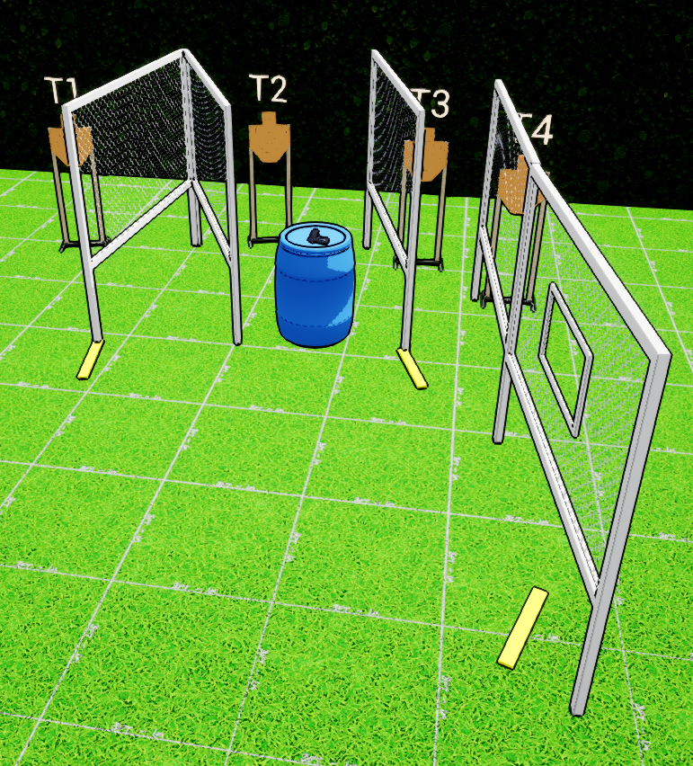
 | Interlake Sporting Association Action Bay, B Stage: Ignore The Man Behind The Curtain Course Designer: Marcel Englmaier & Stanley Lewis
START POSITION: Standing barrel with wrists below belt. Firearm loaded and placed on barrel with muzzle pointed downrange and safeties on |  | STRINGS: 1 SCORING: Unlimited SCORED HITS: 4 START-STOP: Audible - Last shot
STAGE PROCEDURE: At the start signal, engage all targets from available cover positions. Reload required between first and last shot.

